Slide 1
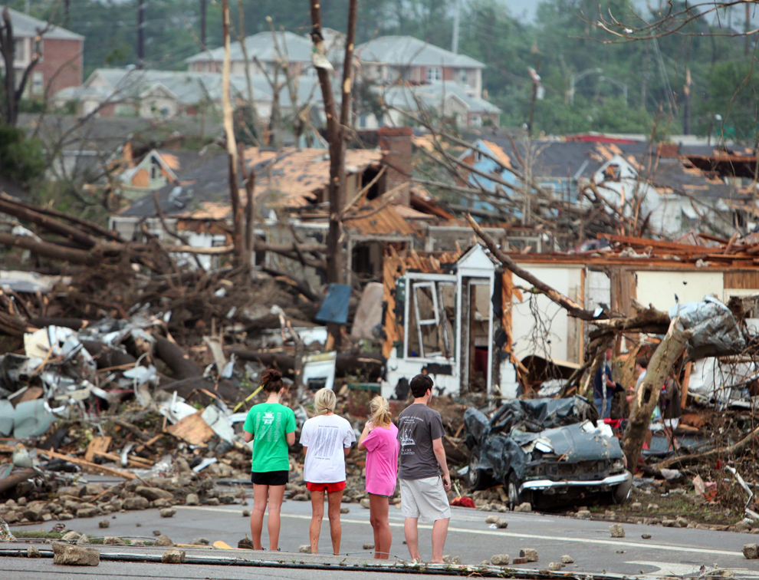
Toto…we’re not in Kansas anymore - A Severe Weather Analysis
Amanda Gaston

Slide 2
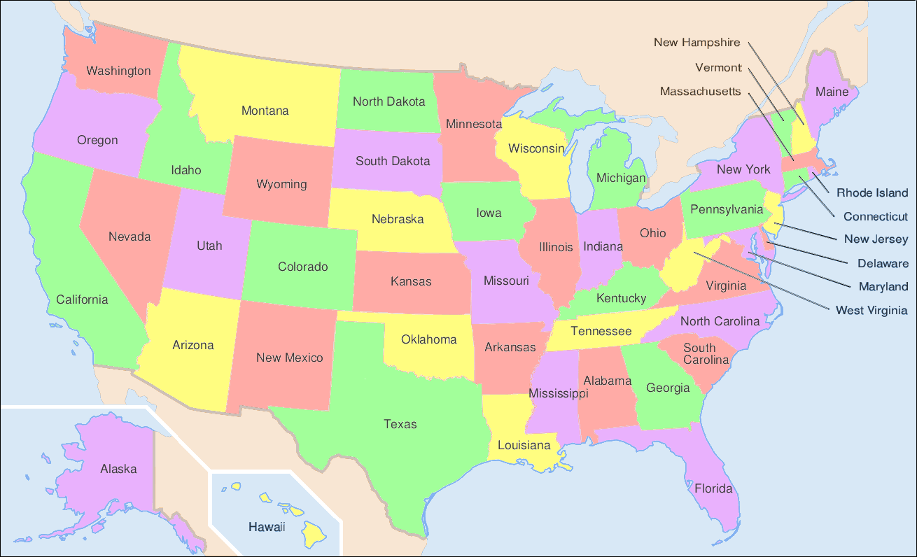
Weather & Geography 101
Where is Tornado Alley?

Slide 3

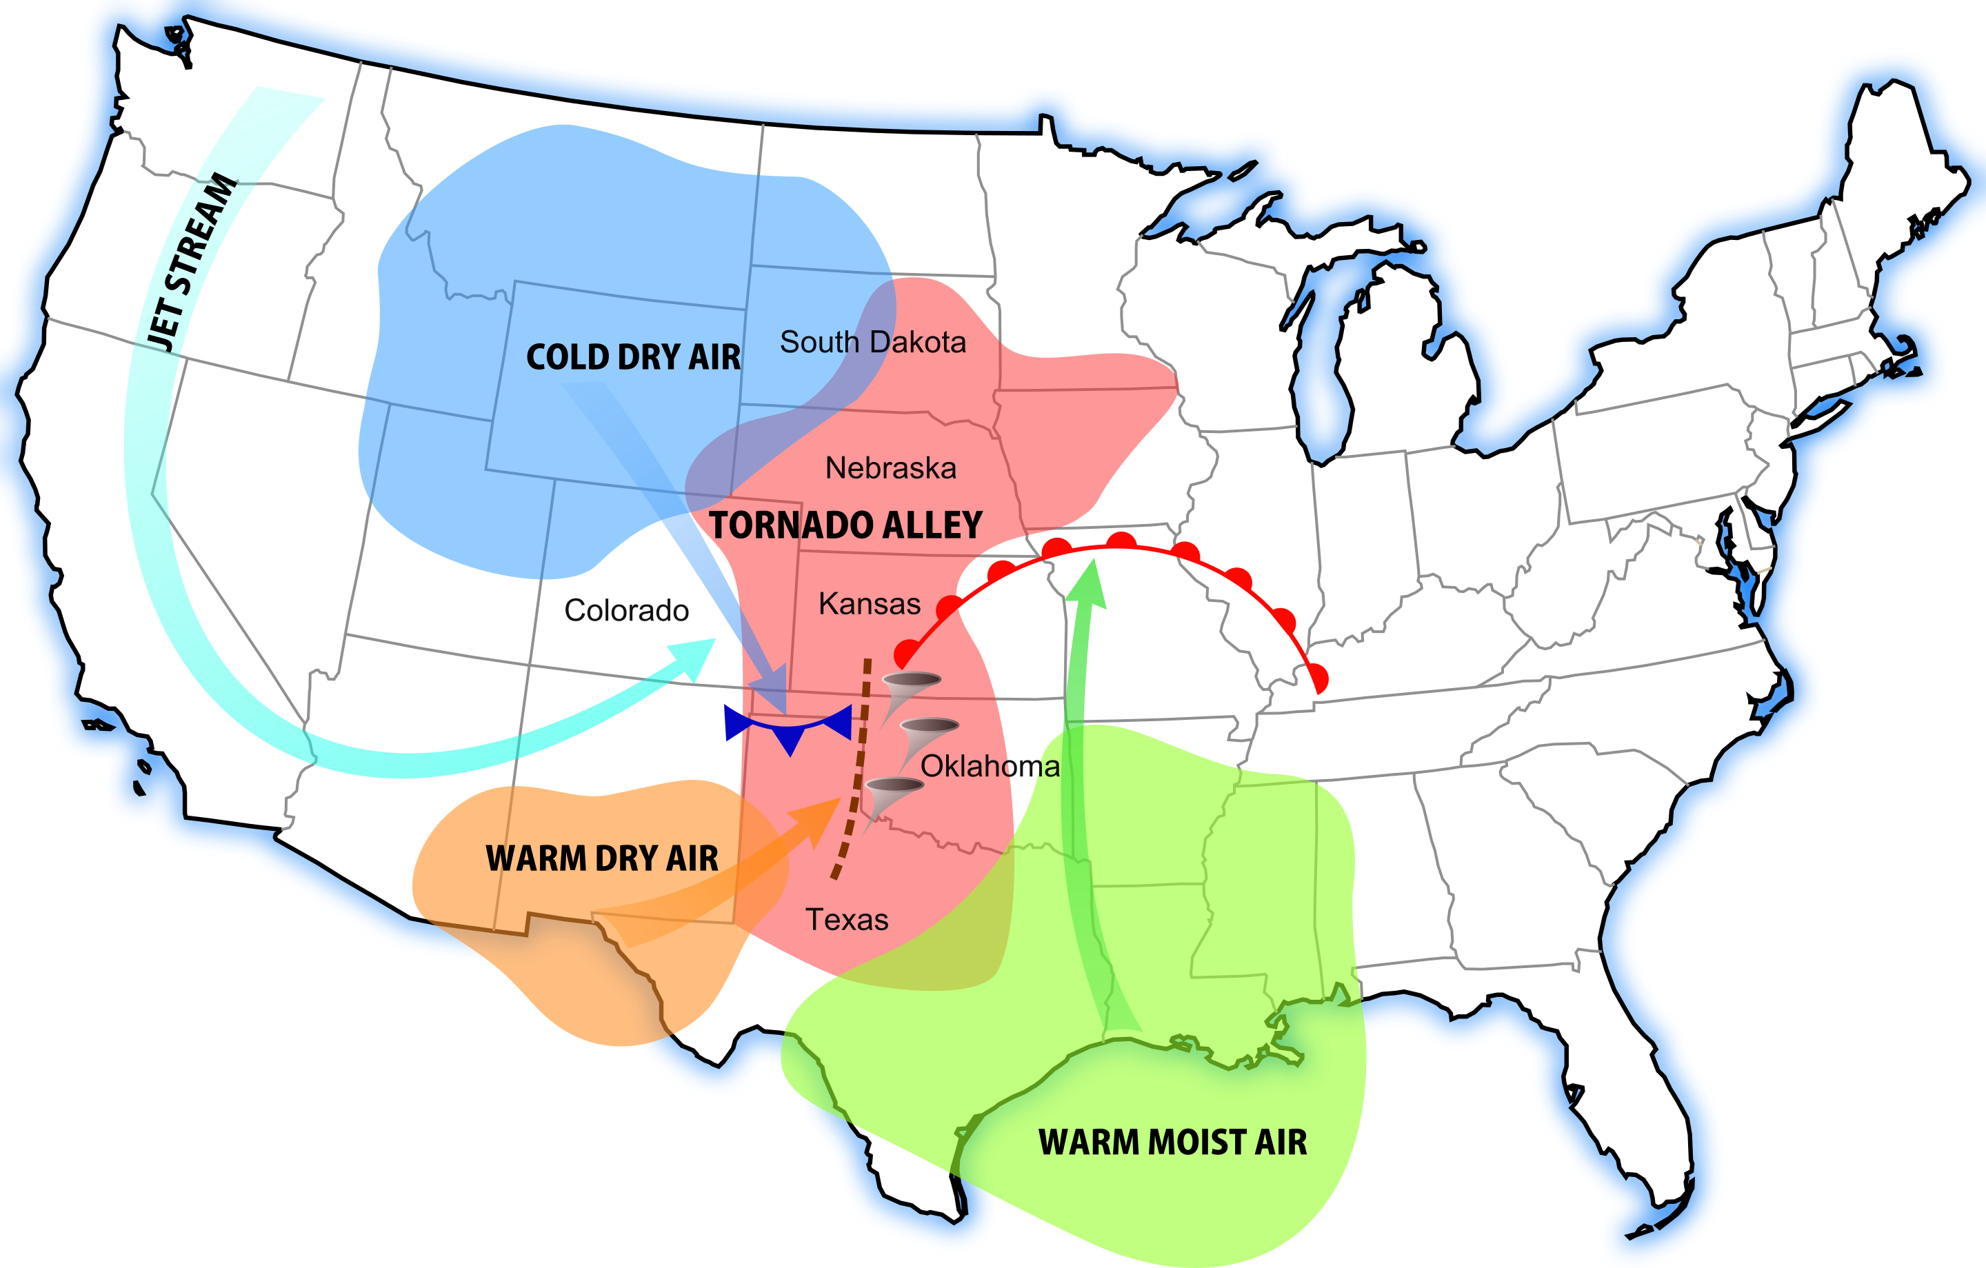

Slide 4
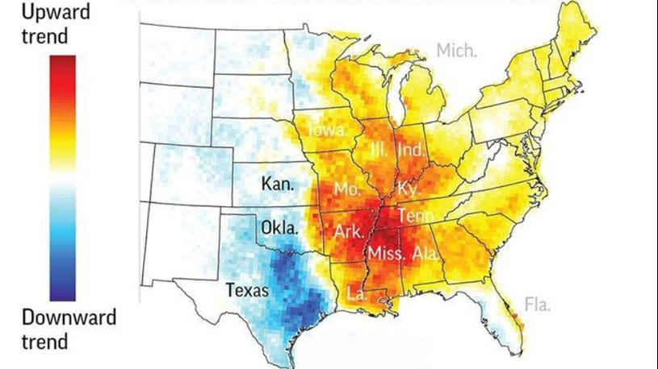
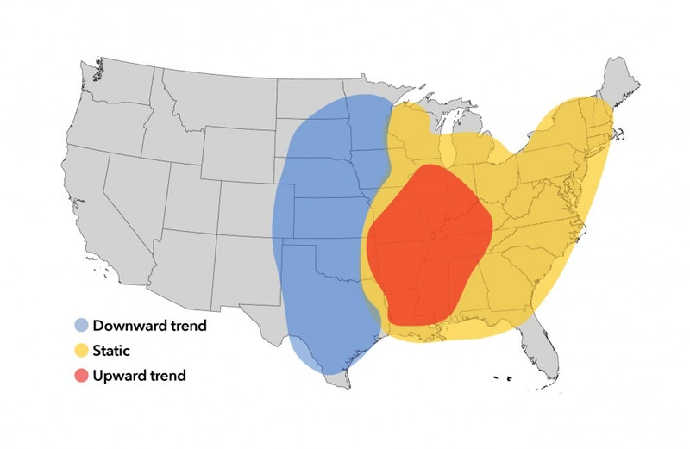
Is Tornado Alley Shifting?
I, along with many much more intelligent people than myself, believe it is shifting more to the East.
These nifty graphs say so, but how do we find out with REAL data?

Slide 5
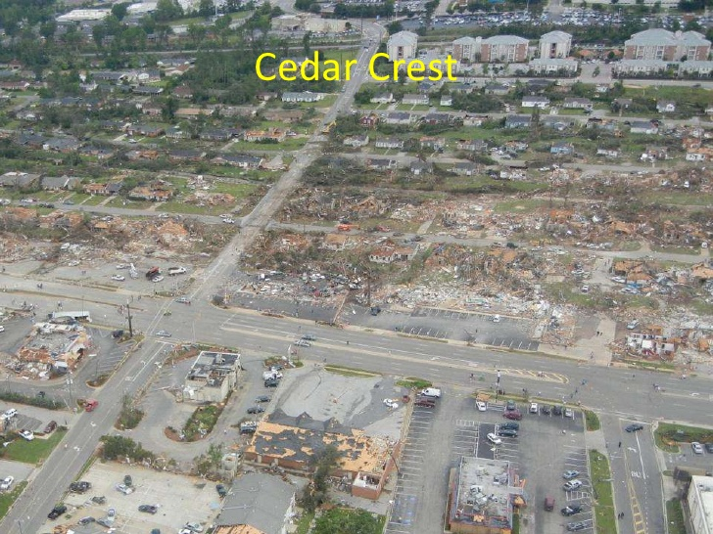
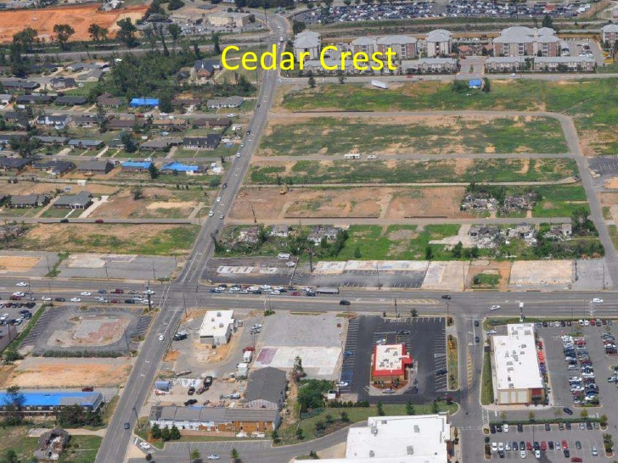

Slide 6
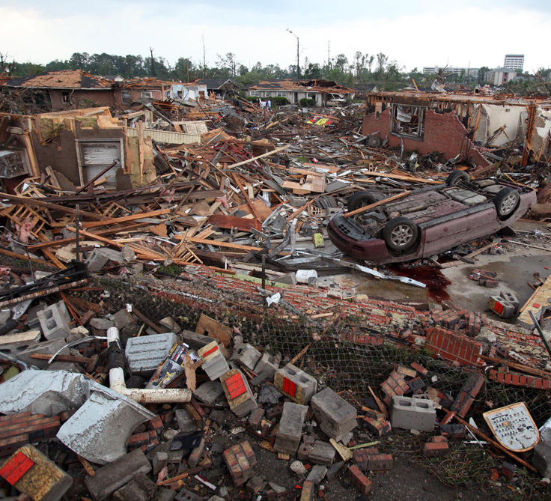
Weather Data
National Oceanic & Atmospheric Administration (NOAA) National Centers for Environmental Information: https://www.ncdc.noaa.gov/data-access/severe-weather
NOAA’s National Weather Service (NWS) Storm Prediction Center (SPC): https://www.spc.noaa.gov/wcm/

Slide 7
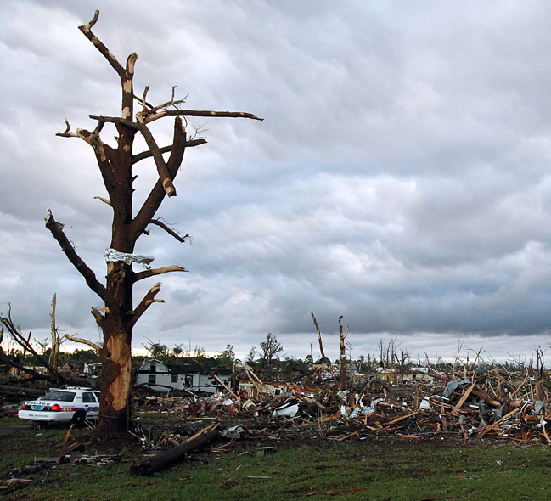
County Data
Census Population Data: https://www.census.gov/library/publications/2011/compendia/usa-counties-2011.html#LND

Slide 8
Additional Data
Homeland Infrastructure Foundation-Level Data for Mobile Home Parks: https://hifld-geoplatform.opendata.arcgis.com/datasets/mobile-home-parks?geometry=-233.525%2C24.207%2C3.955%2C65.072
National Weather Service (NWS) StormReady Counties: https://www.weather.gov/stormready/communities

Slide 9
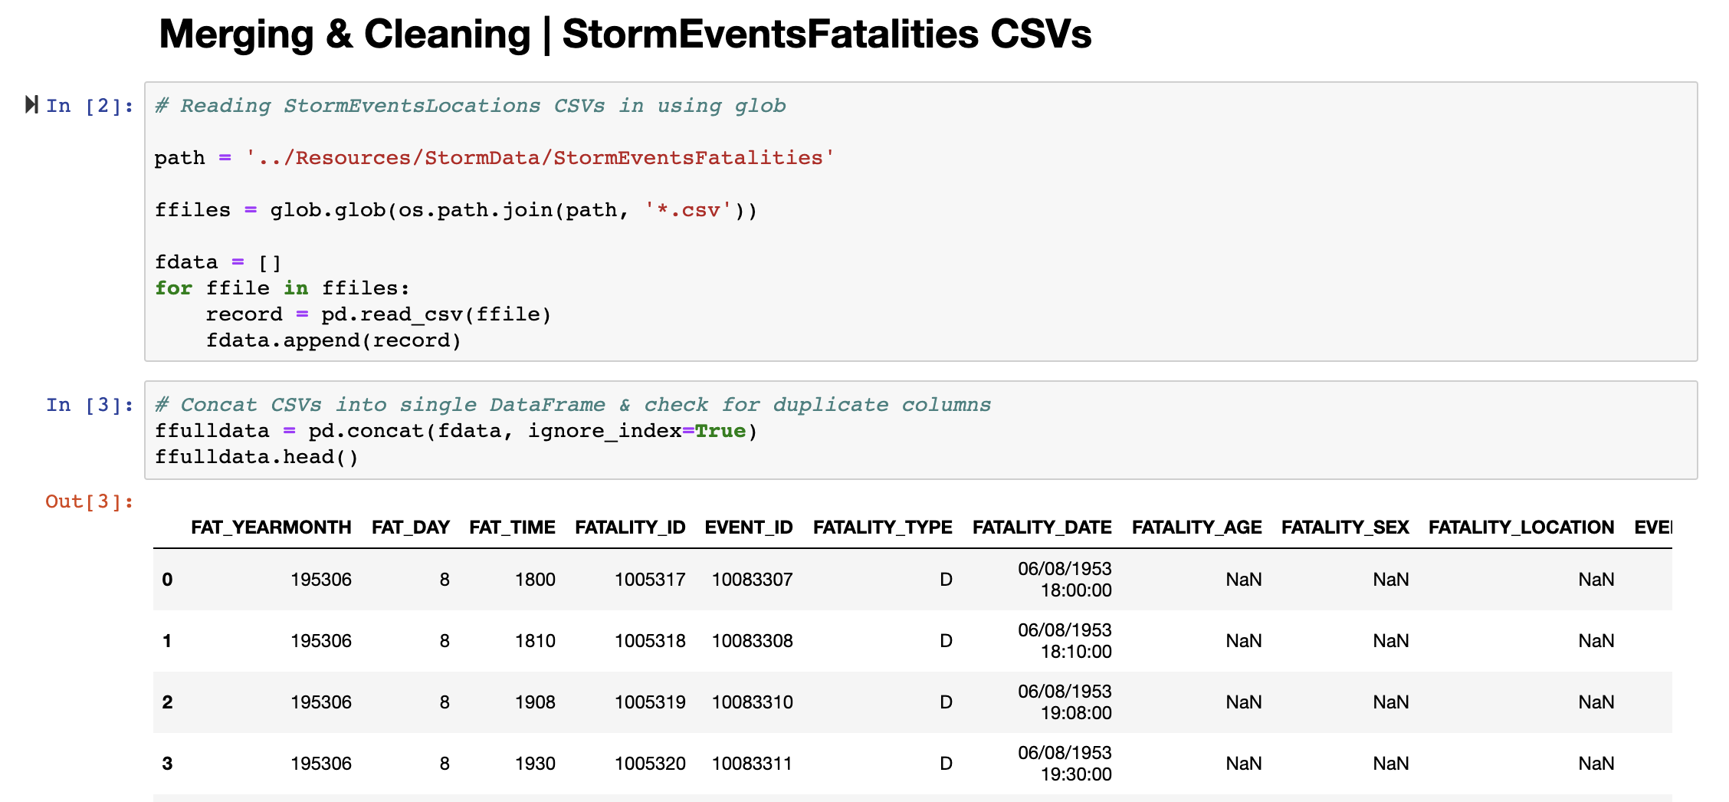
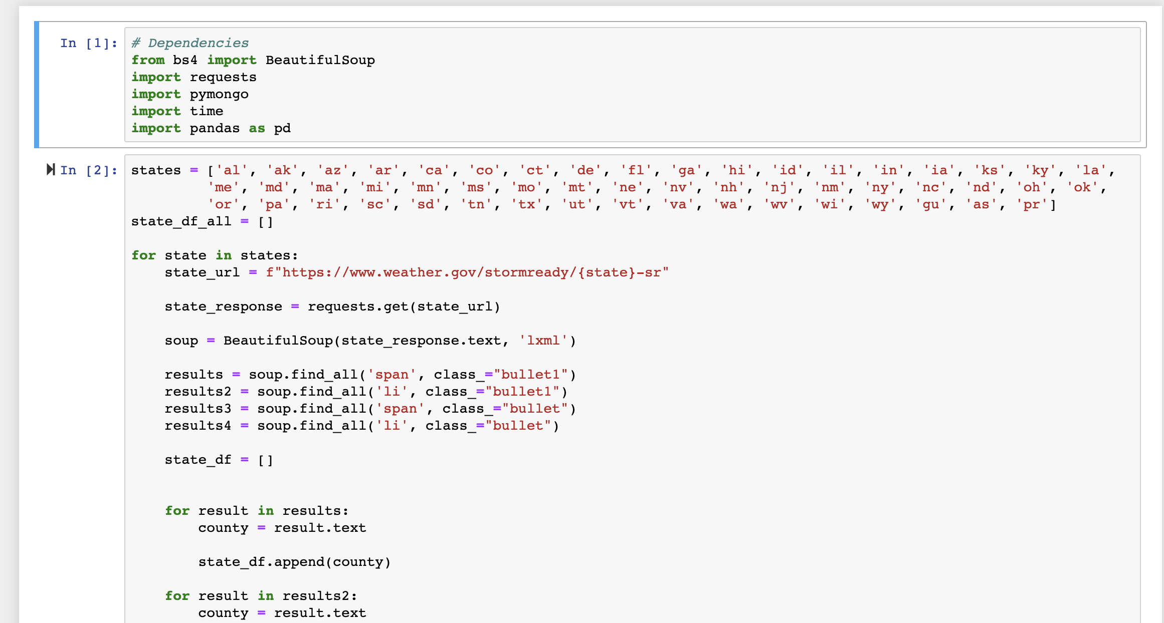
Data Cleanup

Slide 10
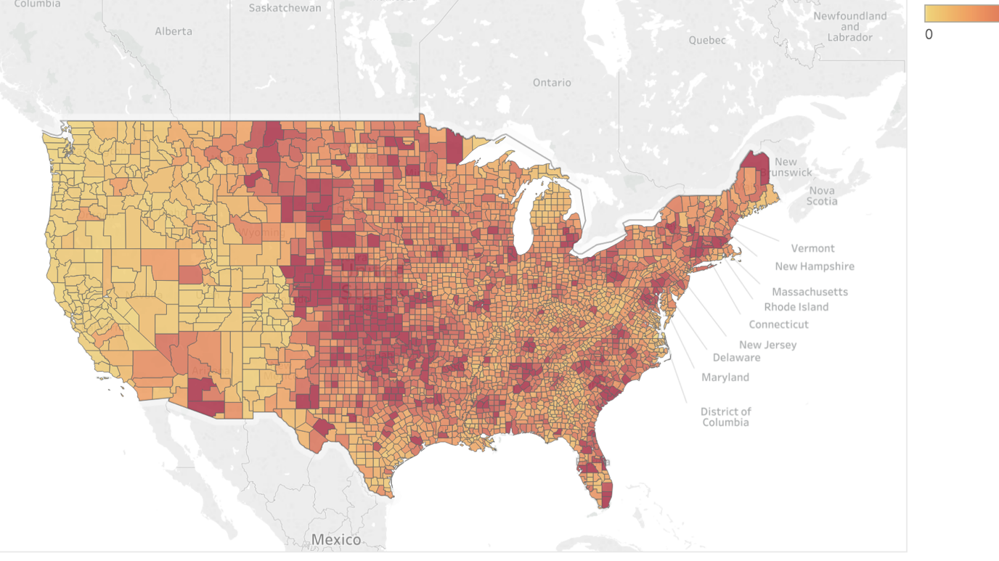
Tableau

Slide 11
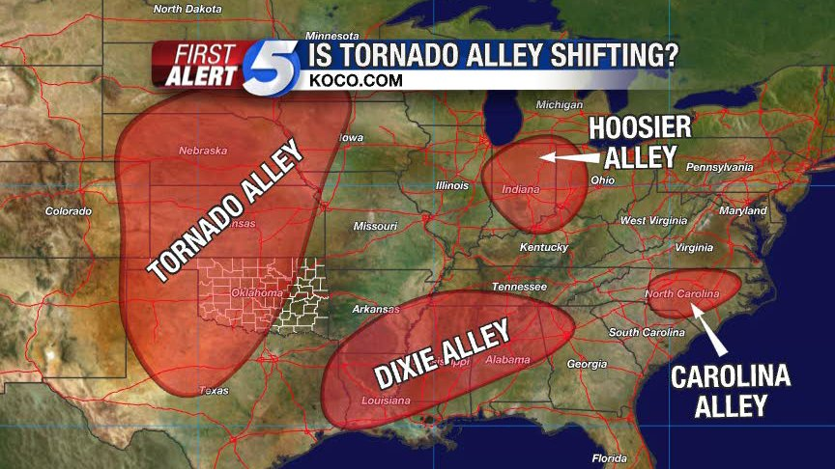
The New Normal?
…or is it more like…

Slide 12





Slide 13
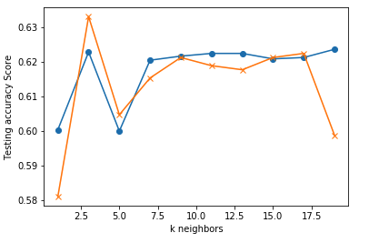
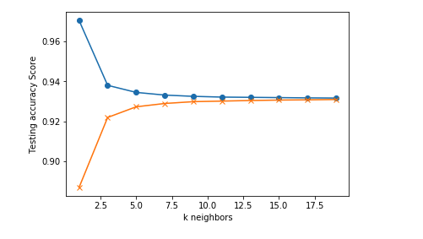
Machine Learning
County Data
Storm Data
Target = Storm Ready? 0-NO | 1-YES
Data = Mobile Home Parks per county
Target = Aggregated Devastation Score
Data = Wx Category, Beginning Lat & Lon
Totally clueless about this part. But I made it work without an error!

Slide 14

Final Advice…
Always remember the difference!
Tornado WATCH: ready to make tornadoes
Tornado WARNING: the tornado is baked and ready to eat you. HIDE!

Slide 15
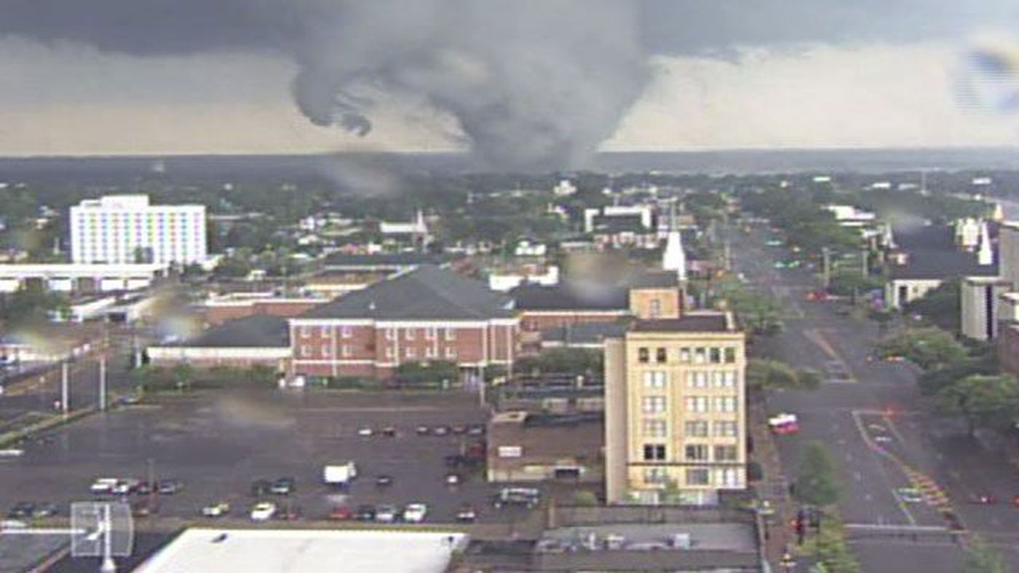
Questions?

